Slide 1
Can you match each slide
to the story….
[you can also look up the story
In your Bible- 1 Kings 17 vs 1-16]

Slide 2
ELIJAH 1 Kings 17 vs 1-6
Food from birds

Slide 3
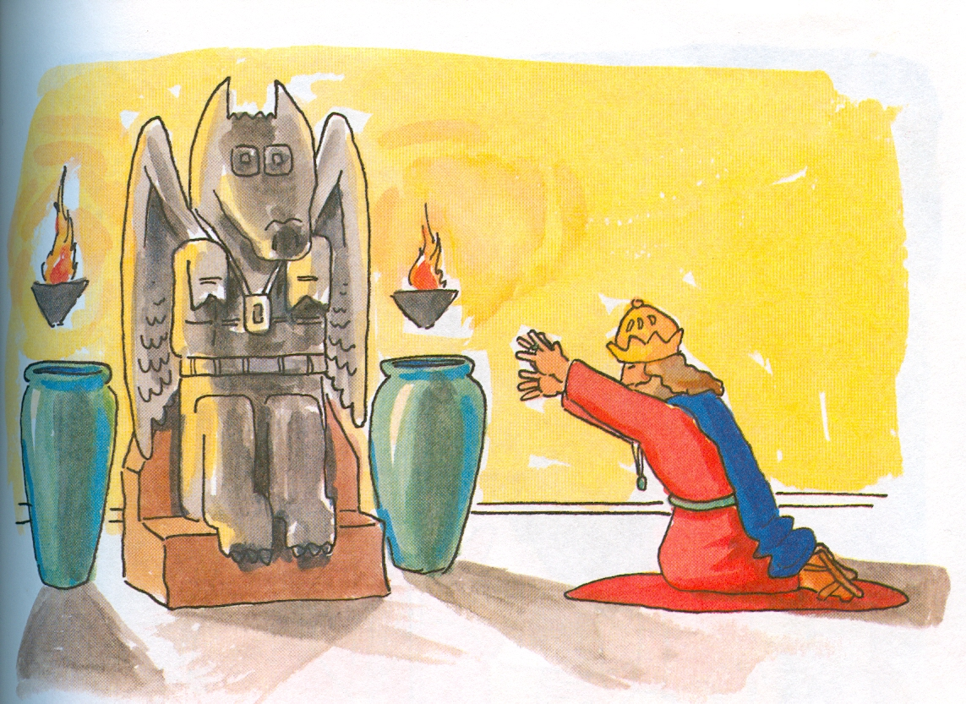
Boo! Boo!
Tut! Tut!

Slide 5
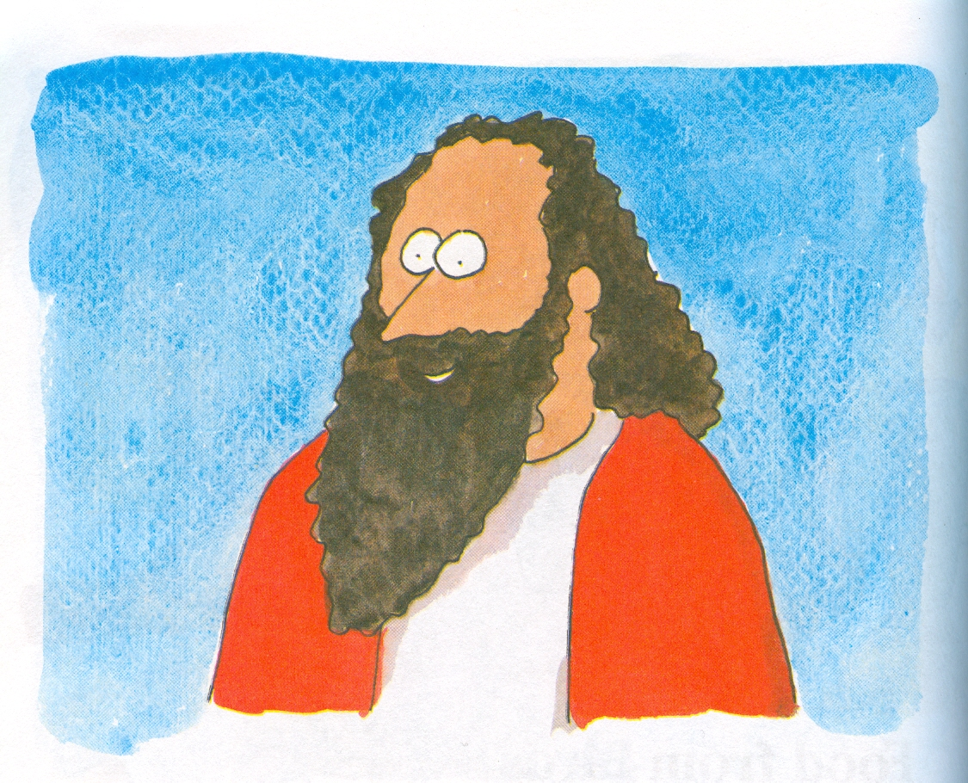

Slide 6
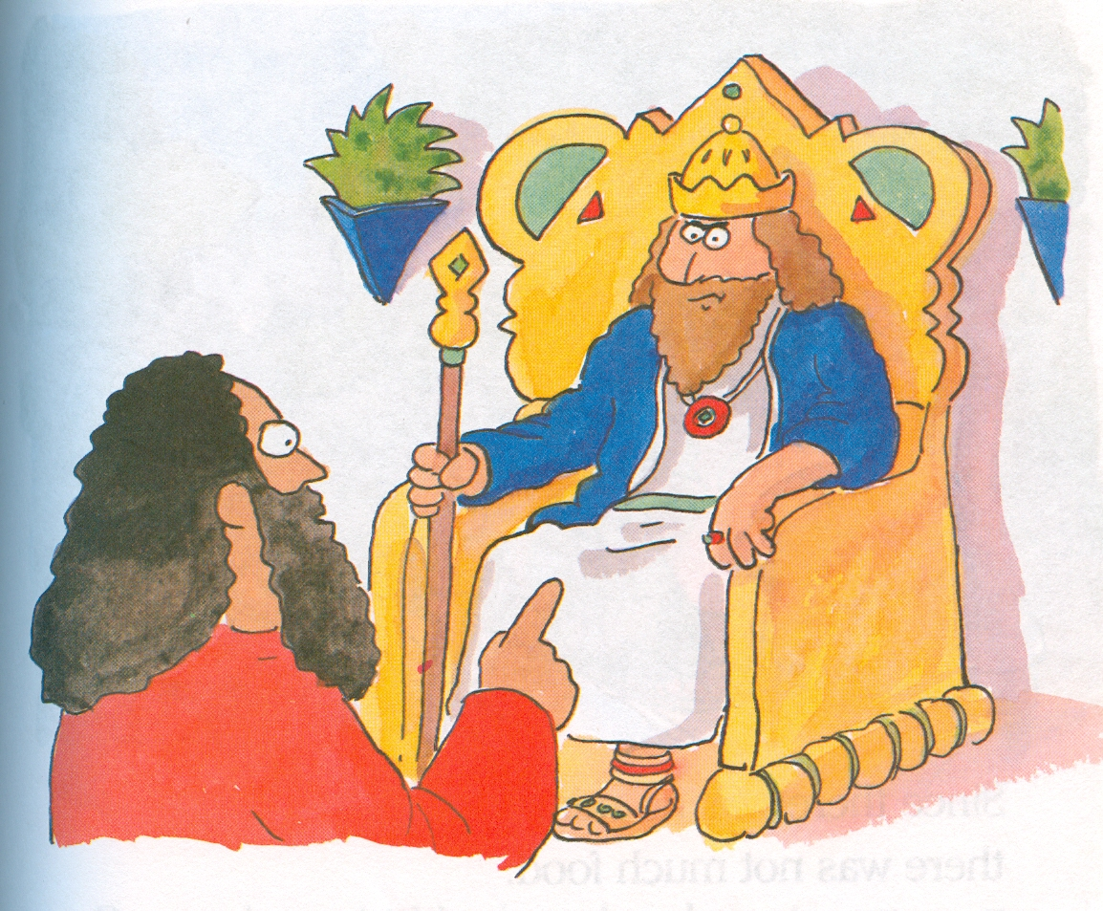
NO
RAIN!
Boo!
Tut tut!

Slide 7
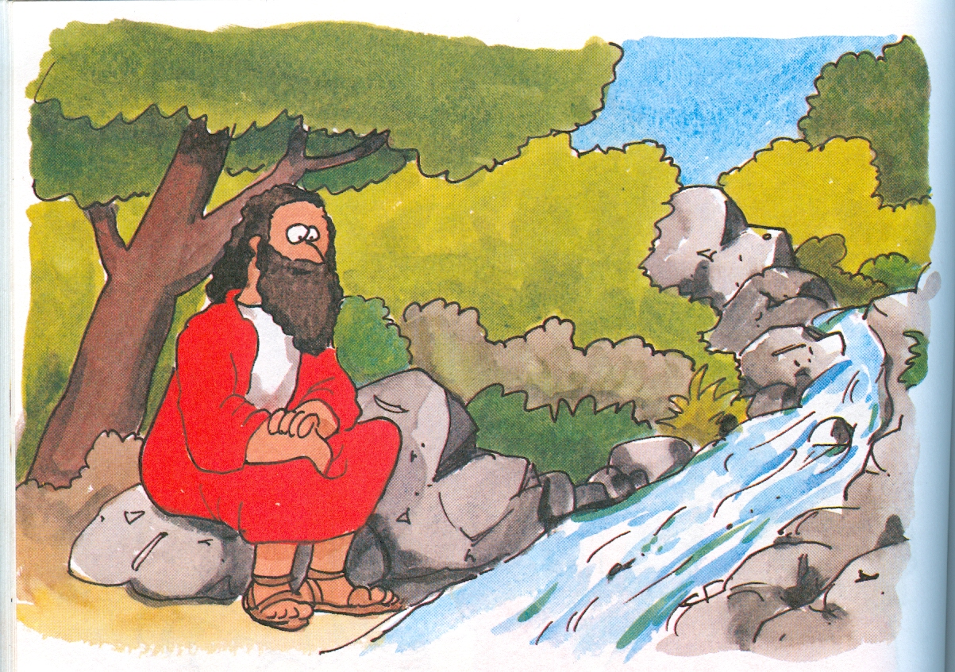
Hurray!
Oh no!

Slide 8
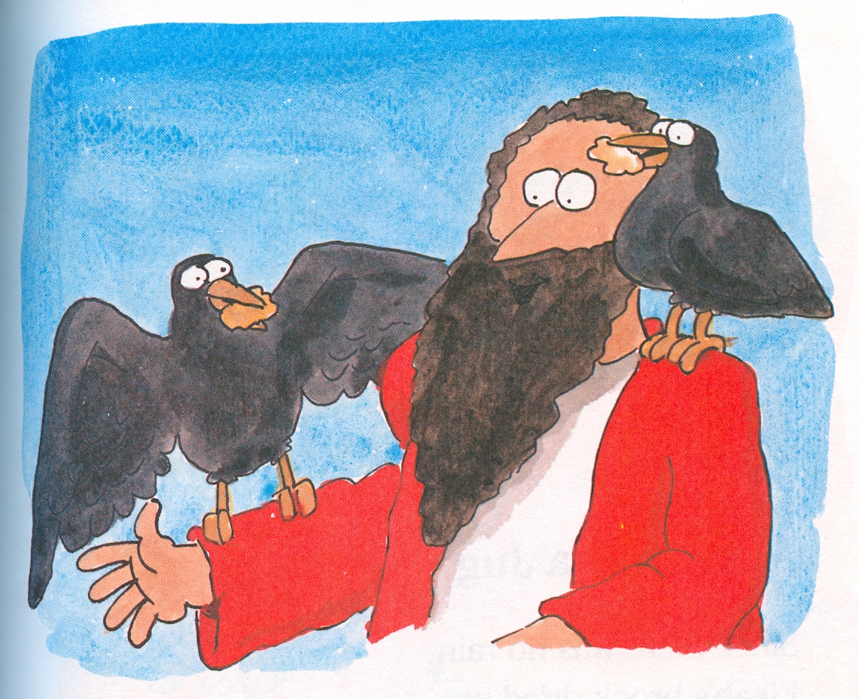
Caw caw..

Slide 9
Thank You dear Lord for feeding Elijah.
Please give us the things we need today.
And make us grateful every day.
AMEN

Slide 10
Next story coming up…

Slide 11
ELIJAH 1 Kings 17 vs 7-16
A jar and a jug

Slide 12
Oh no!
Hurray!

Slide 13
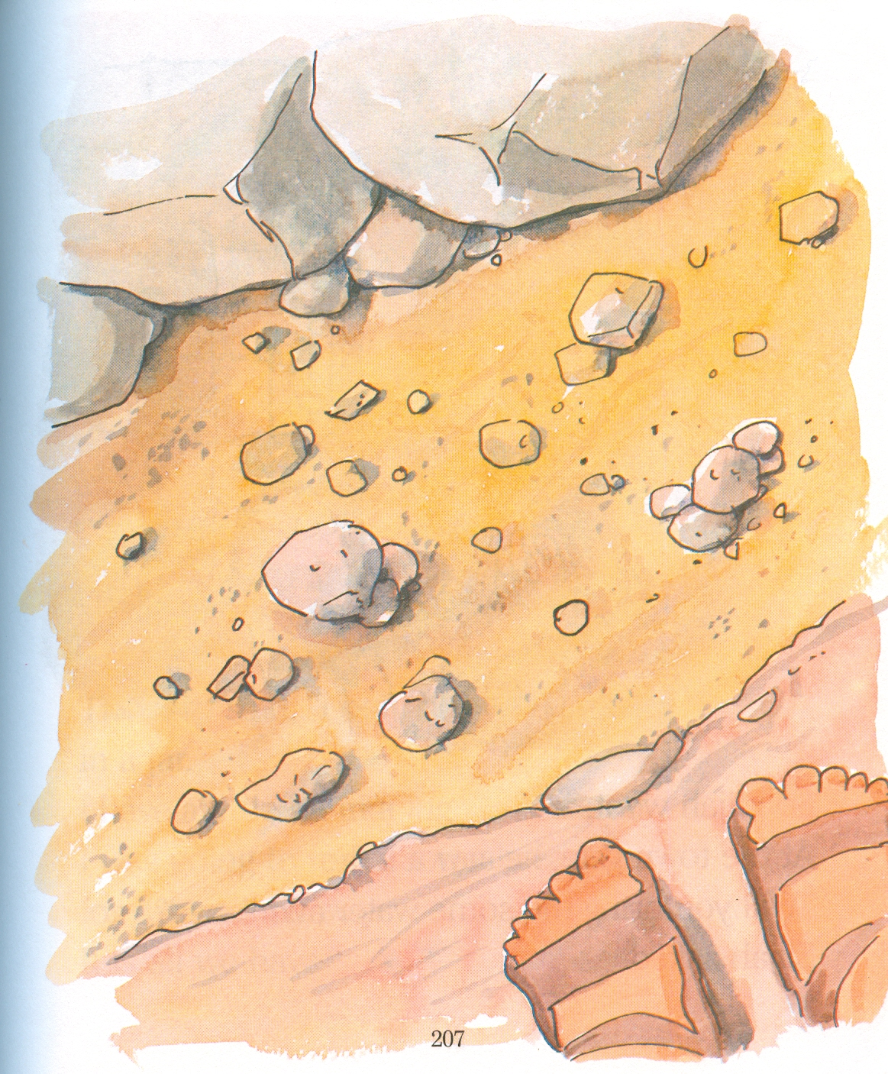
To Zarephath

Slide 14
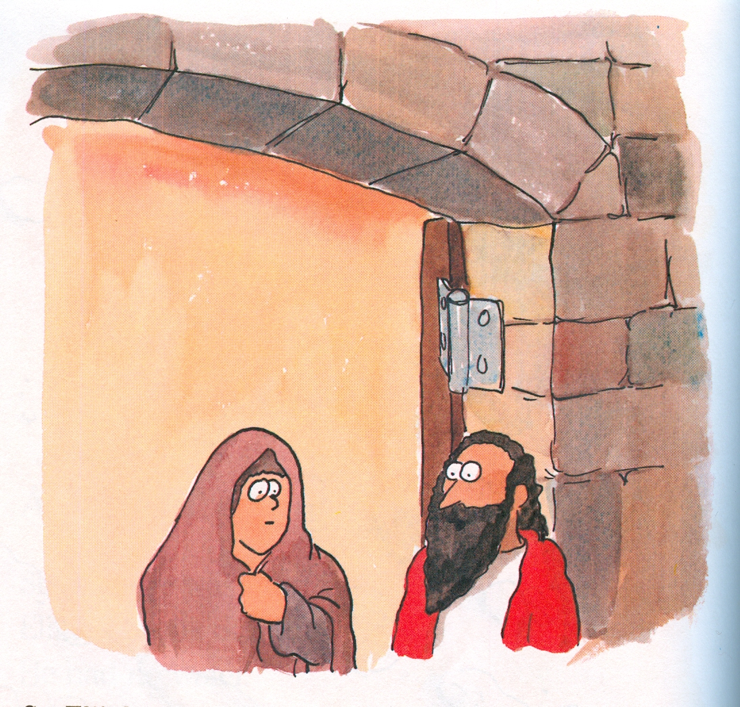
Will you bring me some water and bread?

Slide 15
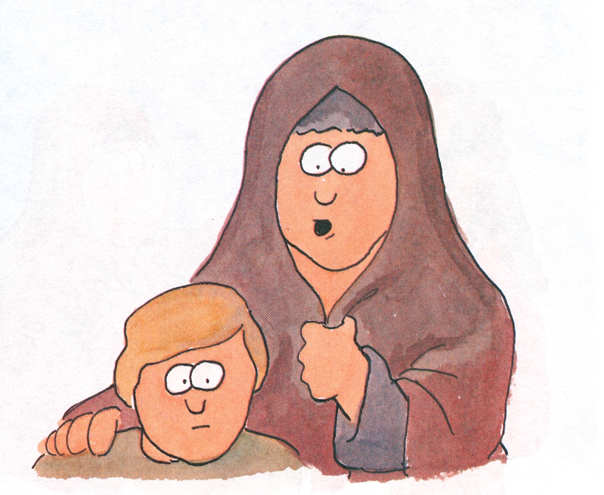
I only have a little flour in a jar

Slide 16
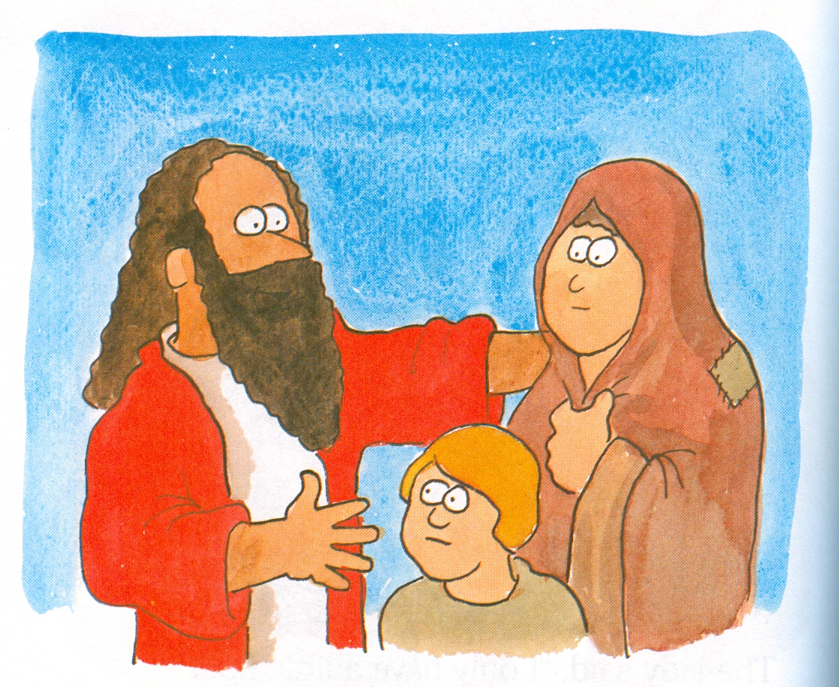
Do not be afraid

Slide 17
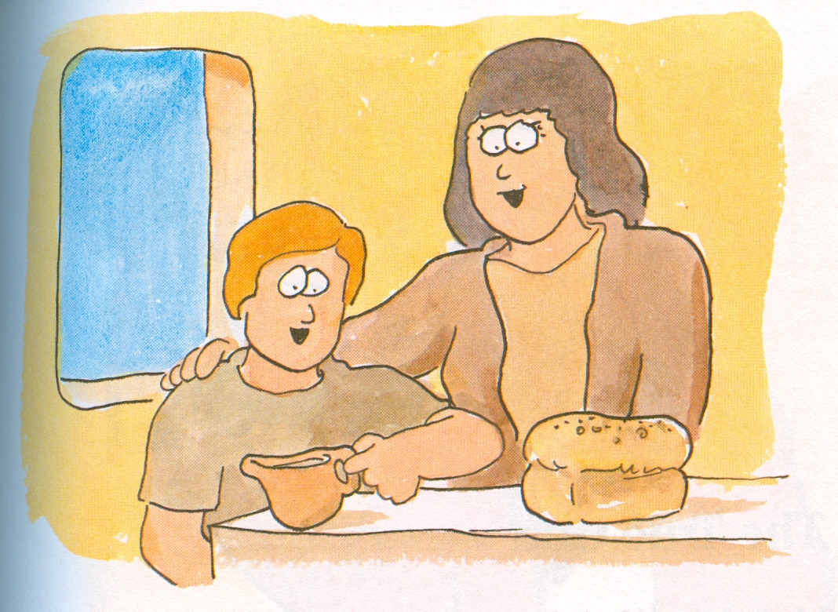
Amazing!!!
Amazing!

Slide 18
What an amazing God!!!!!!!!!

Slide 19
These stories can be found in
1 Kings 17 verses 1-16

